Slide 1
Analysis of the Security Vulnerabilities in Virtual Private Networks
LITERATURE REVIEW
Atiqa Zafar & Zaryab Khan
School of Electrical Engineering and Computer Sciences,
NUST Islamabad, PK

Slide 2
Content
WHAT ARE VIRTUAL PRIVATE NETWORKS
WHY WE CHOSE THE TOPIC
WORK DONE IN THE LITERATURE REVIEW
FUTURE IMPLEMENTATION

Slide 3
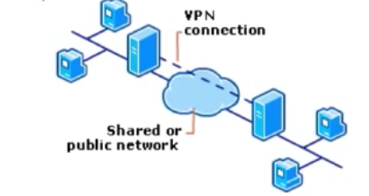
WHAT ARE VIRTUAL PRIVATE NETWORKS
VPN is a network that is constructed by using public wires — usually the Internet — to enable remote users to securely connect to a private network, such as a company's internal network.

Slide 4
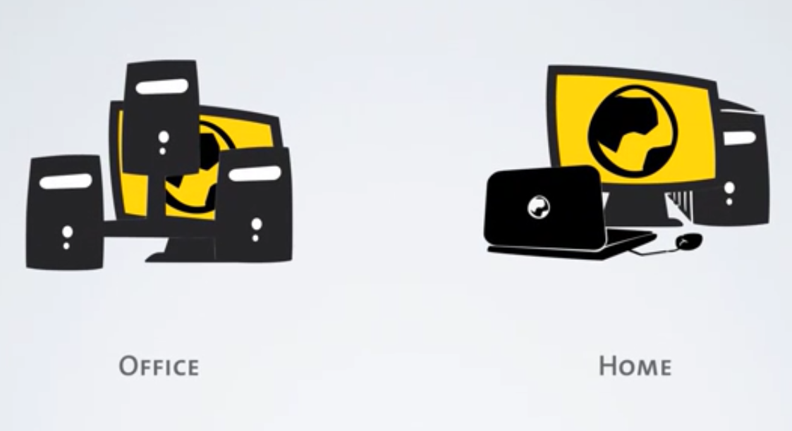

Slide 5
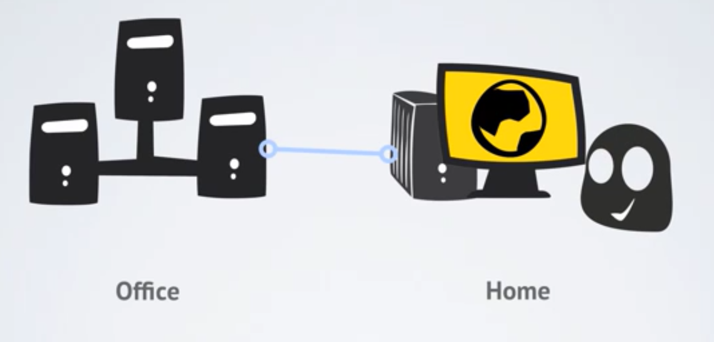

Slide 6
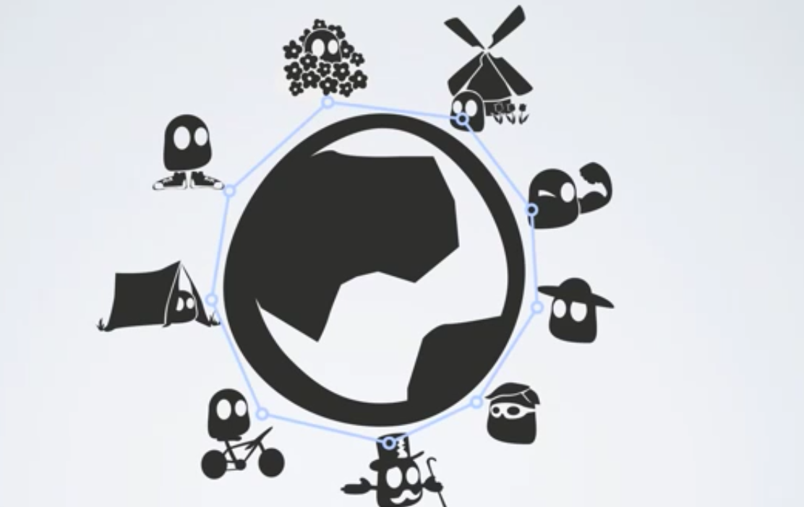

Slide 7
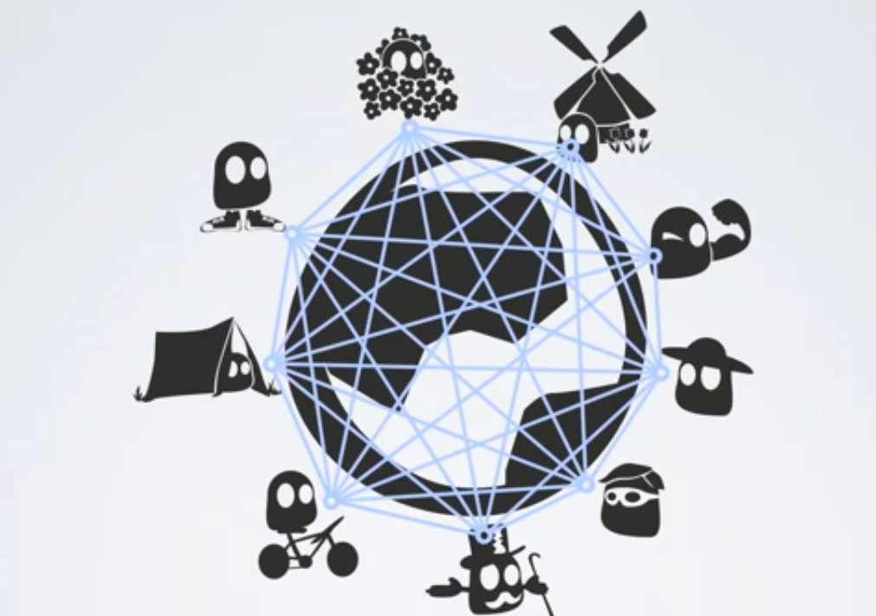

Slide 8

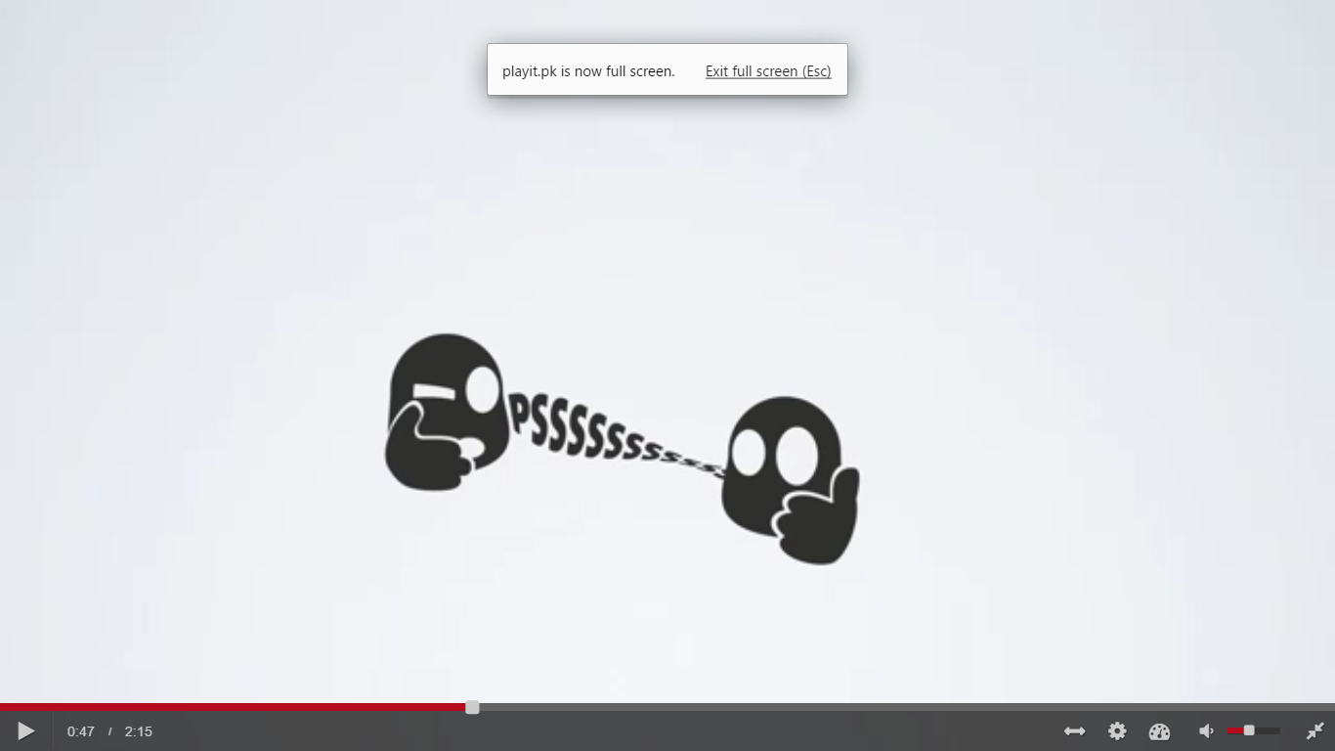
SECURE
ENCRYPTED

Slide 9
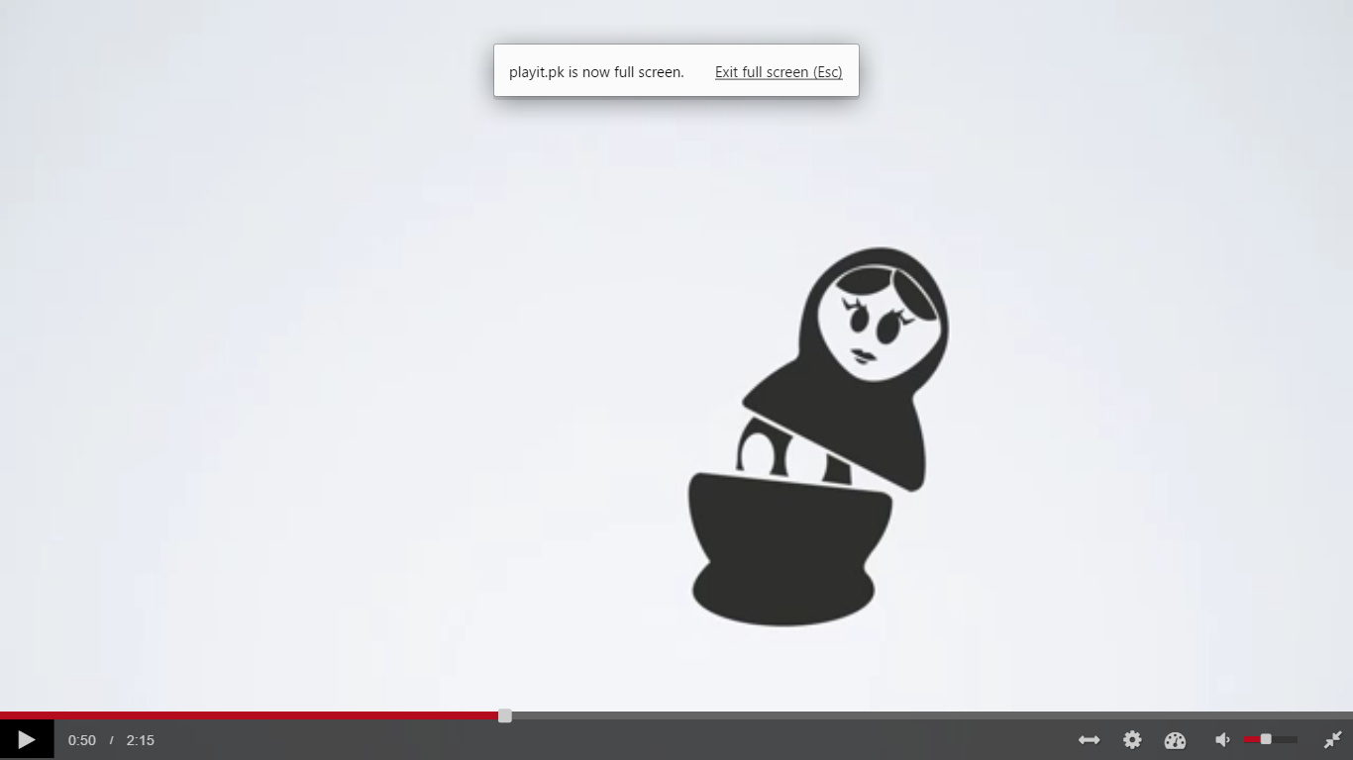

ANONYMITY
PRIVACY
HACKERS
GOVT CENSORSHIP

Slide 10
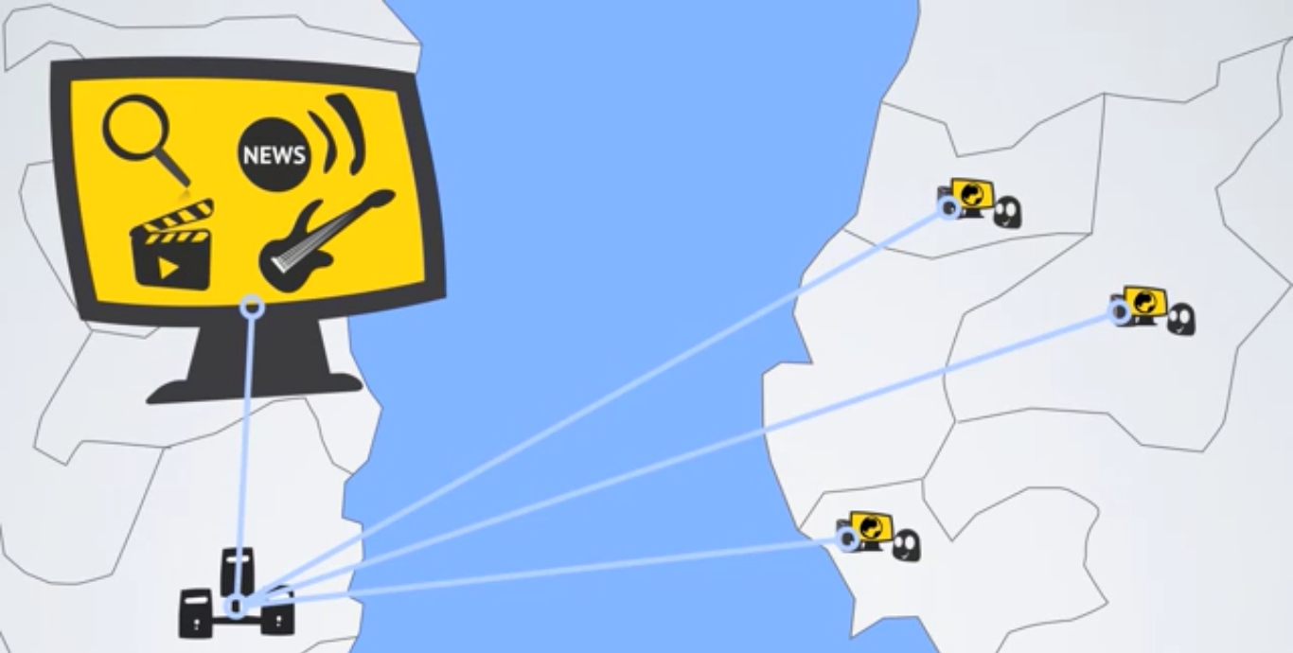
FREEDOM (ACCESS TO BLOCKED CONTENT)
Notes:
Music, News, Video, Search Engines
Because of geo location, some online content

Slide 11
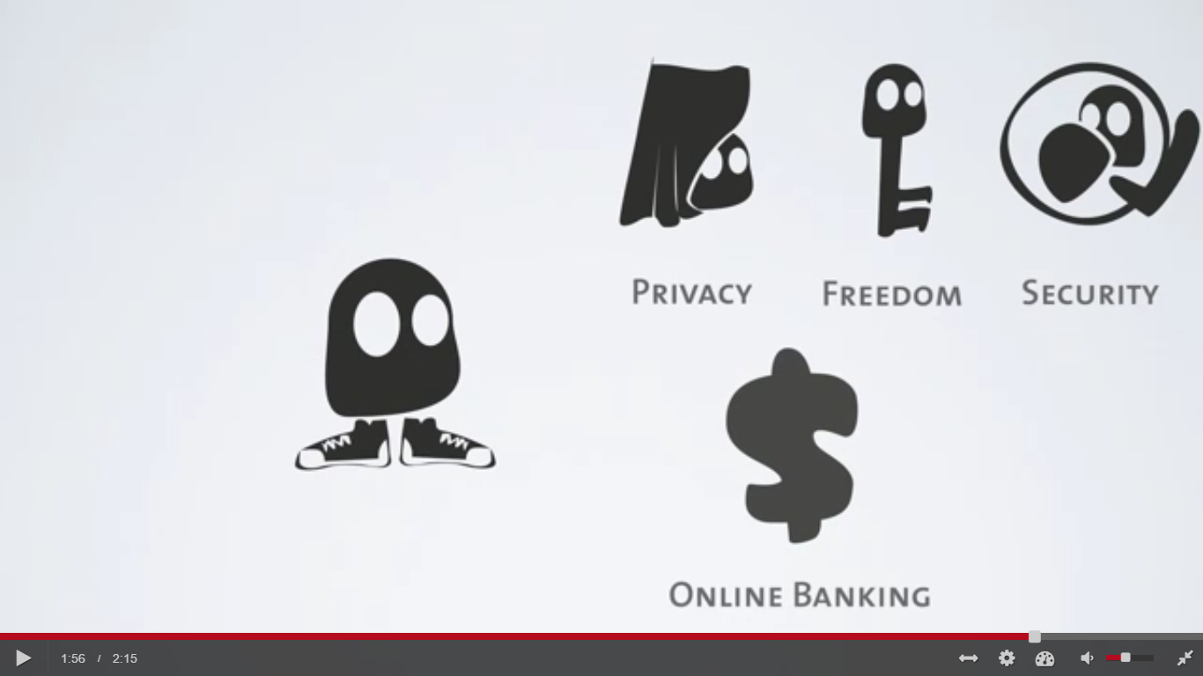
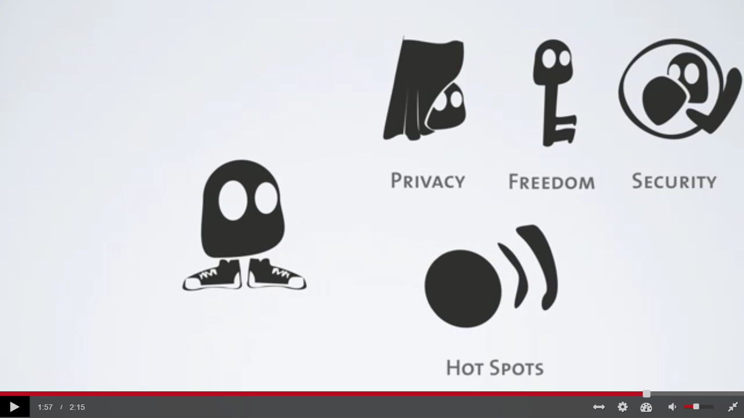
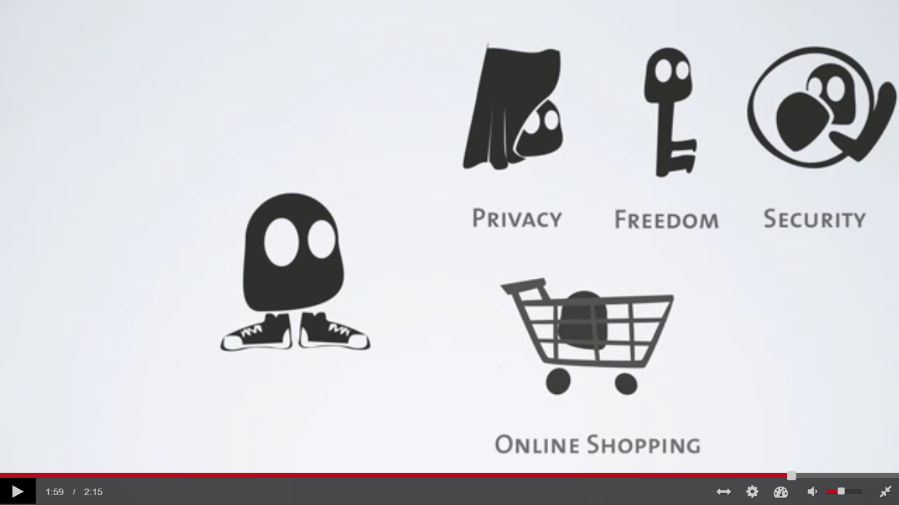
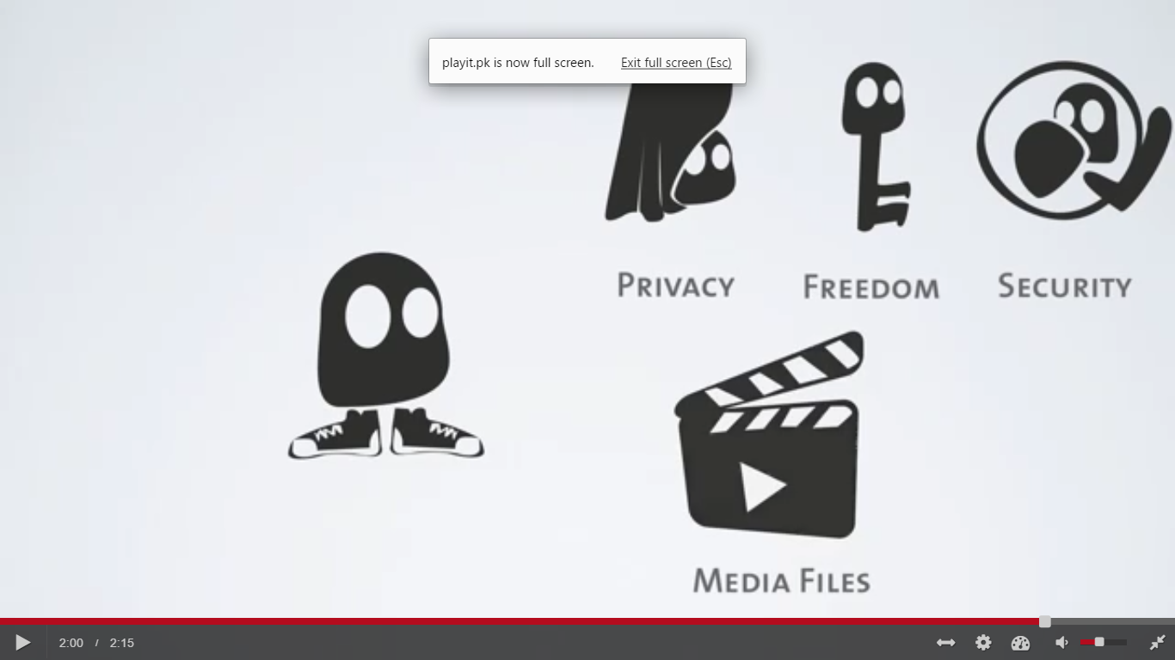
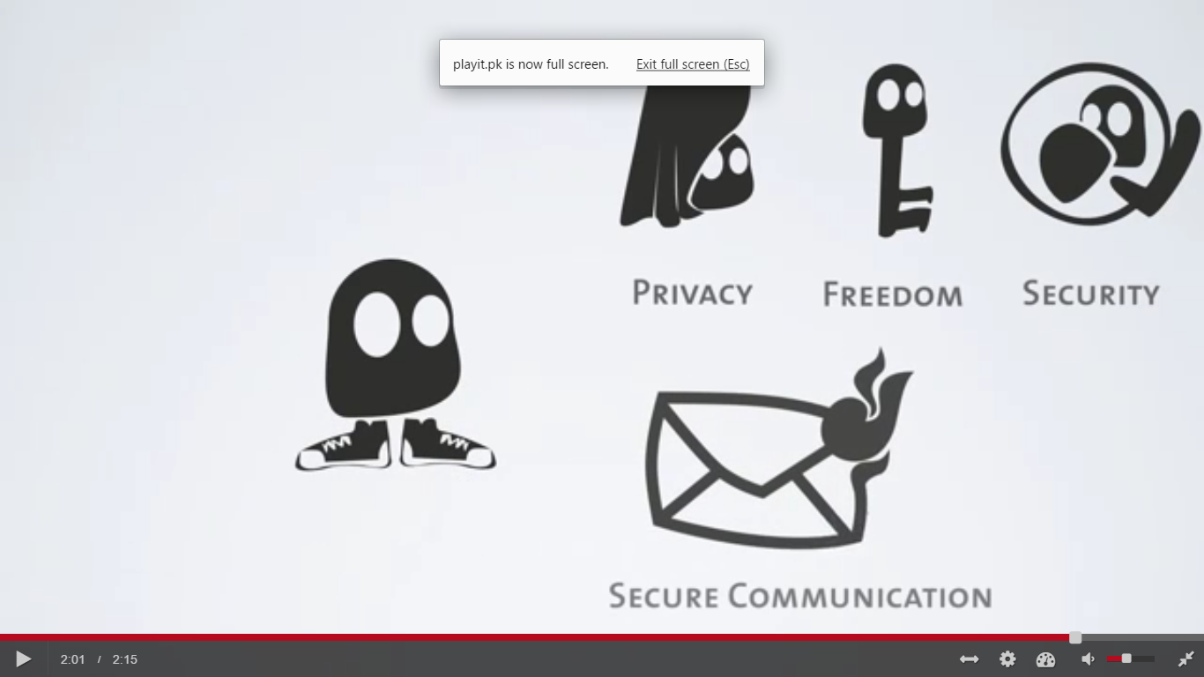
WIFI HOTSPOTS

Slide 12
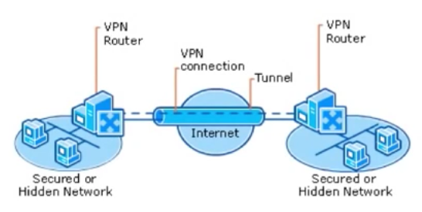
HOW VPNs WORK
Remote Access vs Site-to-Site (Extranet Server)
VNP requirements:
1) Authentication (Identify, Protocols)
2) Tunneling (Encapsulation of packets, Protocols)
3) Encryption (AES, 3DES)
PPTL, IPSEC, L2TP
Notes:
POINT2POINT TUNNELING, IPSEC FRAMEWORK(A,T,E), LAYER2 TUNNELING PROTOCOL

Slide 13
WHY WE CHOSE THE TOPIC
rapid increase in the usage of VPNs by both individuals and organizations
boldly claiming about privacy and anonymity without undergoing any standard evaluations
not the impenetrable, secure systems
open to attacks such as IPv6 leakage, DNS hijacking, Offline Password Cracking, Man-in-the-Middle Attacks and Malware Infections etc. Over half of the 16 VPN services, looked into by a group of researchers[19] from Sapienza University of Rome and Queen Mary University of London, used the Point-to-Point Tunneling Protocol with MS-CHAPv2 authentications, which makes them vulnerable to brute force hacks.

Slide 14
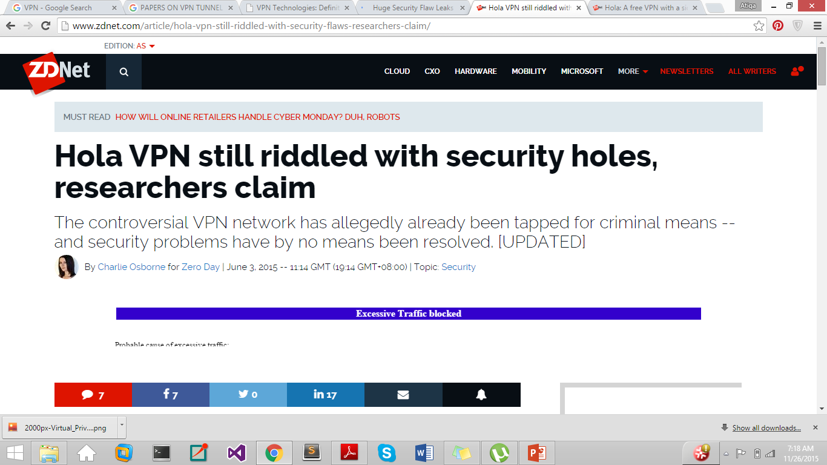
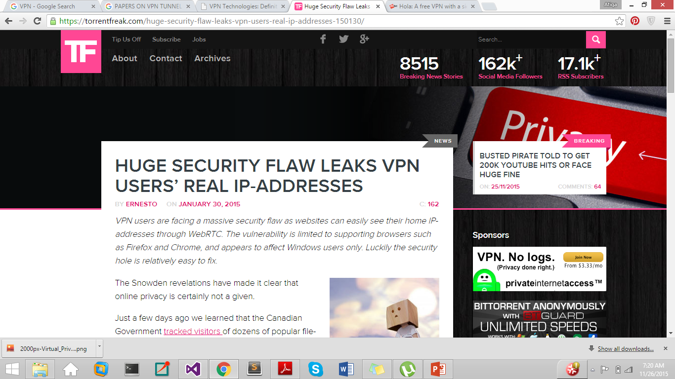
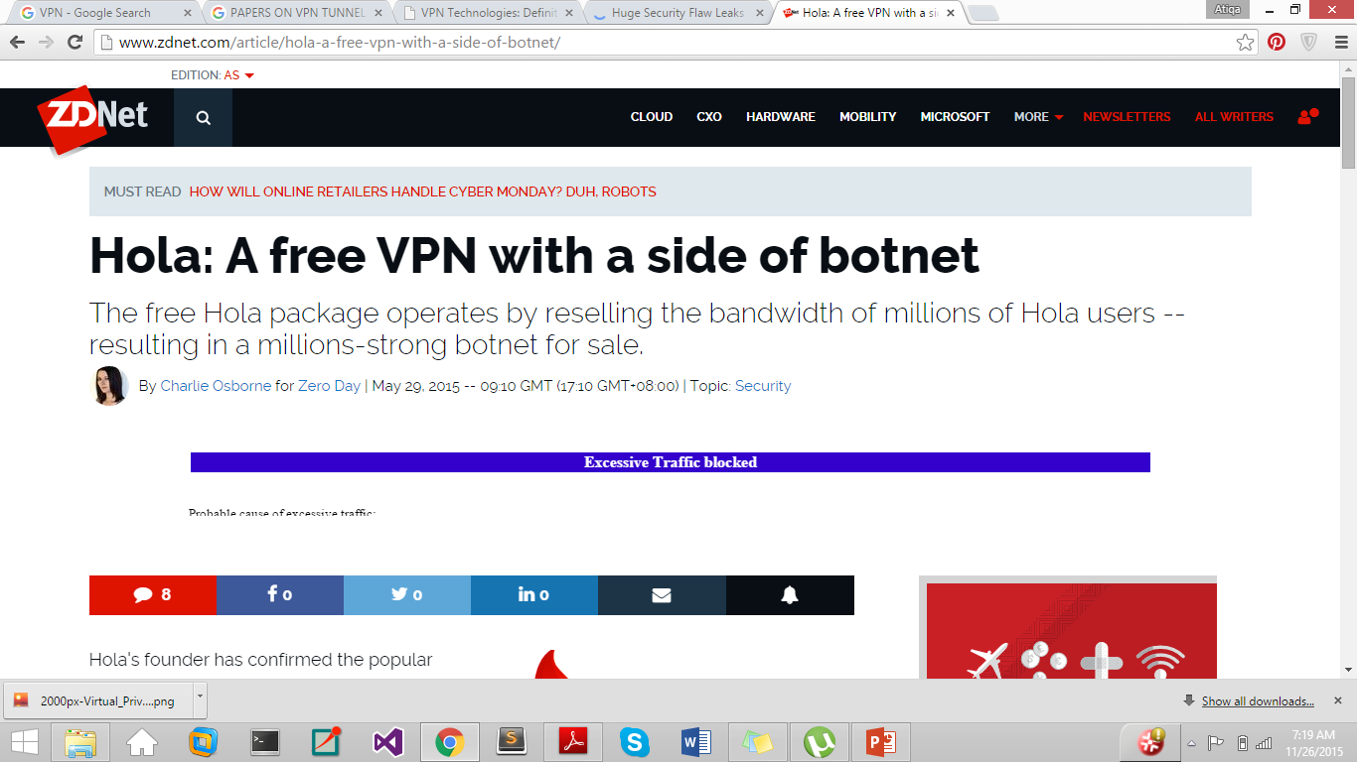
Israel-based Hola - a popular VPN provider used by roughly 46 Million users worldwide to make tracking their internet activity more difficult to track, was caught for selling the bandwidth of individuals using the free version of the software to cover operational costs

Slide 15
Work done in Literature Review
Surveyed the tunneling technologies most commonly used by VPN service providers.
Studied 11 research papers, multiple RFCs and online articles to thoroughly understand the security vulnerabilities in VPNS.
Pointed out seven vulnerabilities and discussed the possible attacks in detail.
3.1. Compromise of User Anonymity
(user authentication credentials on the client machine)
3.2. Username Enumeration Vulnerabilities (response to an incorrect login attempt )
3.3. Offline Password Cracking (Dictionary Attacks - IKE Aggressive Mode with pre-shared key (PSK) authentication - MS-CHAPv2, of PPTP )
3.4. Impersonating Client & VPN Hijacking
3.5. MitM Attacks and Traffic Leakage using IPv6 (SLAAC Attack’)
3.6. Routing Table Attacks
3.7. DNS Hijacking Attacks (DHCP for default, Route Injection Attacks)
Discussed range of best practices and countermeasure techniques already available to deal with these vulnerabilities when implementing a virtual private network.
Notes:
Dynamic Host Configuration Protocol (DHCP) is a client/server protocol that automatically provides an Internet Protocol (IP) host with its IP address and other related configuration information such as the subnet mask and default gateway.
Slaac stateless Address Auto Configuration

Slide 16
Table 3.1 lists the experimental results for DNS hijacking against all the VPN clients tested in the study [19]

Slide 17
A number of papers were studied and discussed in the review. However, we want to conclude our paper with highlighting the three most important publications dealing with VPN security vulnerabilities to date.
R.Hills[20] “Common VPN Security Flaws Whitepaper” 2005
- VPN configurations utilizing the IPsec protocol.
- A portion of the issues that have been seen, for example, the username identification issue, were new revelations, while others are known constraints of the protocols, which are presented because of poor configuration.
Appelbaum et al. [18] “vpwns: Virtual pwned networks,” 2012
- a scientific categorization of configuration issues
- experimentally watched the issue of IPv6 leakage in certain VPNs.
"A Glance through the VPN Looking Glass: IPv6 Leakage and DNS Hijacking in Commercial VPN clients" , 2015
- evaluation of sixteen commercial VPN services
- measuring the VPN client’s IPv6 traffic being leaked over the native interface
- carrying out two DNS hijacking attacks.

Slide 18
Future Implementation
Carry out the possible security attacks on the VPNs to highlight the vulnerabilities found during the literature Review.

